Slide 2
PrEP and Men: A man’s got to do, what a man’s got to do.
Dr Saiqa Mullick, Wits RHI
@WitsRHI
Share your thoughts on this presentation with #IAS2019

Slide 3
Context: It’s time for a conversation about male risk
HOWEVER!
In South Africa, approximately 7.9 million people of all ages are living with HIV and 199 700 people (aged 15 to 49 years) were newly infected with HIV in 2017.
Young boys and men are an important target group if we are to break the cycle of HIV transmission.
Sexual debut before the age of 15 years among male youth has steadily increased and continues to do so.
The number of adolescents girls in sexual relationships with older sexual partners continue to increase.
Condoms are not used consistently (at 53%) among males and females.
HIV peak prevalence occurs at an older age among males (45-49 years) compared to females.
Increased incidence among males aged 15-24 years in 2017.
Males are less likely to test for and/or know their HIV status. Of those who know their status treatment initiation remains low. Viral suppression lowest among males and younger age groups.
Citation: Human Sciences Research Council (HSRC) (2018). The Fifth South African National HIV Prevalence, Incidence, Behaviour and Communication Survey, 2017: HIV Impact Assessment Summary Report. Cape Town, HSRC Press.
Citation: Human Sciences Research Council (HSRC) (2018). The Fifth South African National HIV Prevalence, Incidence, Behaviour and Communication Survey, 2017: HIV Impact Assessment Summary Report. Cape Town, HSRC Press.
Hannaford, A., Khoza, B., Moll, A. P., & Shenoi, S. V. (2018). 1300. Young Heterosexual Men in Rural South Africa Want Access to PrEP. Open Forum Infectious Diseases, 5(Suppl 1), S397. doi:10.1093/ofid/ofy210.1133
Verguet S, Stalcup M, Walsh JA Where to deploy pre-exposure prophylaxis (PrEP) in sub-Saharan Africa? Sexually Transmitted Infections 2013;89:628-634.
All photographs used are courtesy of Adobe Stock, standard licensing – appearance in a photograph in this presentation does not indicate a person’s health status.

Slide 4
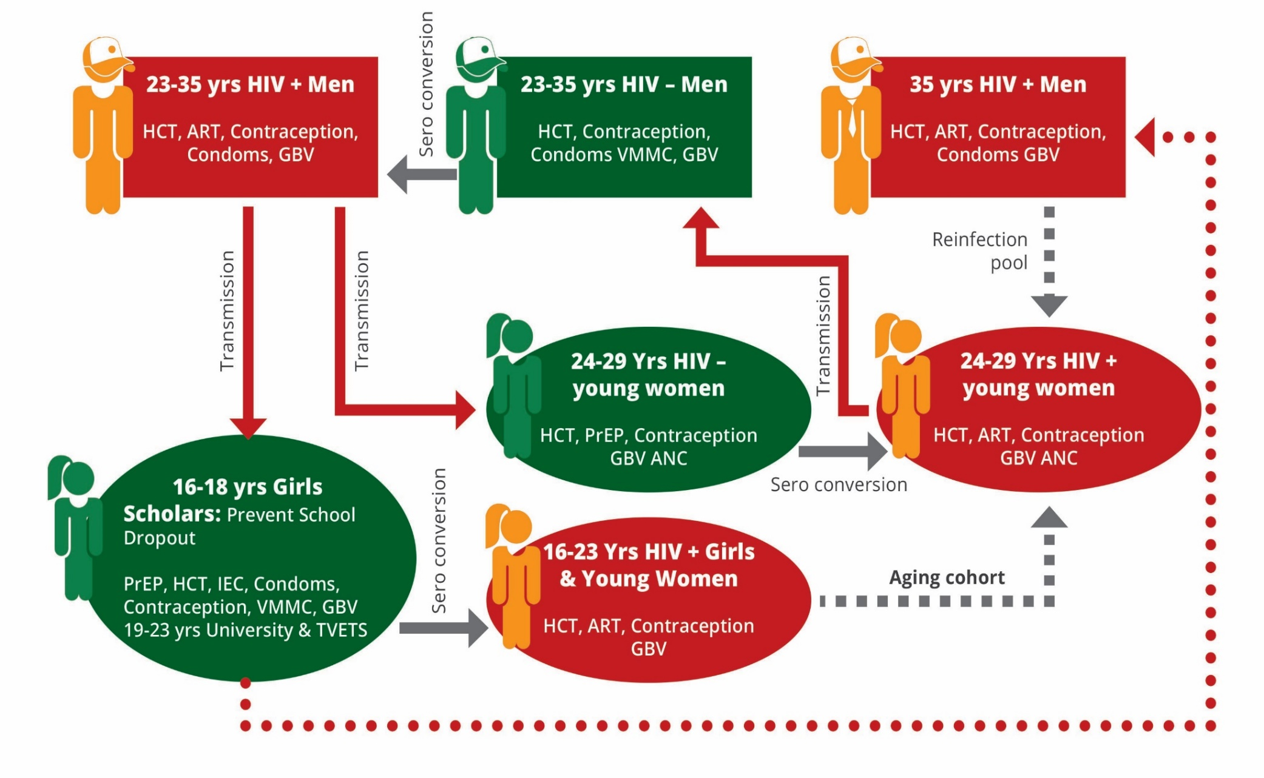
South African transmission model
PrEP
PrEP
PrEP

Slide 5
PrEP: a novel intervention for men?
What do WHO recommendations mean in practice?
The WHO and National Department of Health in SA recommends PrEP for those at risk of HIV. Males are among those who may benefit from access to PrEP.
In South Africa in high prevalence areas, such as KwaZulu-Natal, men have shown a growing interest in initiating PrEP.
MSM and transgender women
Serodiscordant couples
Sex workers
People who inject (and use) drugs
Adolescent girls and young women
Others who ask for PrEP
Hannaford, A., Khoza, B., Moll, A. P., & Shenoi, S. V. (2018). 1300. Young Heterosexual Men in Rural South Africa Want Access to PrEP. Open Forum Infectious Diseases, 5(Suppl 1), S397. doi:10.1093/ofid/ofy210.1133
(KZN men interested in PrEP)
Number of countries citation - Fitch L et al. Tracking global oral PrEP provision: the who, what and where of oral PrEP. HIV Research for Prevention conference (HIVR4P 2018), Madrid, October 2018, abstract OA04.01.

Slide 6
All photographs used are courtesy of Adobe Stock, standard licensing – appearance in a photograph in this presentation does not indicate a person’s health status.
What do we know about SA men and boys?

Slide 7
South Africa PrEP initiations, 2016-2019 by gender and site type (N= 25 687)
Note: Data as of May 2019

Slide 8
All photographs used are courtesy of Adobe Stock, standard licensing – appearance in a photograph in this presentation does not indicate a person’s health status.
What insights are research projects in South Africa demonstrating?

Slide 9
Common risks
Sample: 2019 Males, 20-34 year, sexually active, randomly sampled across 5 districts of KZN and 3 districts of MPU
HIV prevalence | 15%
Circumcision status | Not circumcised – 38% Circumcised traditionally – 16% Circumcised in a clinic before age of 16 – 26% Circumcised in a clinic after age of 16 – 19%
Condom use | Base: n=1945 (sexually active respondents in the last year) Condom usage has varied from partner to partner in last year – 57% Always used a condom in the last year – 32% Never/ didn’t’ use condoms in the last year – 11%
Age at sexual debut | Mean: 16
Number of partners | In the last year, mean: 2.4 Current, mean: 1.3
Characterisation of partners | Base: n=1945 (sexually active respondents in the last year) Wife/husband/main partner: 48% Another regular girlfriend/ boyfriend: 65% Casual hookup/ one night stand: 18% Sex worker: 4% Blessee: 8% Blesser: 1%
Alcohol consumption | % who strongly agree or slightly agree with the statements: Sometimes I do things I regret when drinking alcohol: 42% Sometimes when I drink alcohol I feel out of control: 37% Drinking alcohol helps me pick up women: 37%
Citation:
Breaking the Cycle: Increasing uptake of HIV testing, prevention and linkage to treatment among young men in South Africa, Population Services International, 2019.
All photographs used are courtesy of Adobe Stock, standard licensing – appearance in a photograph in this presentation does not indicate a person’s health status.

Slide 10
All photographs used are courtesy of Adobe Stock, standard licensing – appearance in a photograph in this presentation does not indicate a person’s health status.
Project PrEP

Slide 11
Project PrEP objectives
Increase accessibility of PrEP for eligible AGYW population (15-24) in project implementation areas
Demonstrate effective delivery models and appropriate use of PrEP amongst adolescents
Generate and disseminate evidence on the use of PrEP in real life settings
Develop strategies to identify AGYW at highest risk
Test various demand creation strategies
Test different HIV screening/testing mechanisms
Reach over 600 000 AGYW and initiate 6640
Access AGYW through public facilities
Offer, initiate and retain AGYW on PrEP
Learn about how to deliver HIV prevention services, PrEP specifically, to AGYW
Gather evidence on cost-effective and successful service delivery mechanisms and interventions
Inform future scale up by NDoH of PrEP provision

Slide 12
Implementation model:
Linking and attracting AGYW to PrEP
RESOURCES
Utilising existing NIMART trained nurse in clinic and other trained staff to provide PrEP to AGYW
Capacity building and mentorship of providers throughout the project
Assisting facility to create youth friendly zones and provide youth friendly SRH and HIV services
Roving unit equipped with NIMART nurse, counsellor and data capturer
Have provided one data collection clerk per clinic to support enhanced monitoring activities
Use biometric system to monitor AGYW, presenting in clinic and collect data on which services are accessed
DEMAND CREATION OUTREACH ACTIVITIES – PARTNERS, YOUTH CONNECTORS & CBOs REFERRING AGYW TO ROVING UNIT OR CLINIC#1 / CLINIC#2 FOR SERVICES
FIXED FACILITY CLINIC#1 – ANCHOR WITH TRAINED NDOH STAFF AND WITS RHI MONITORING STAFF
ROVING UNIT ANCHORED TO THE FACILITY, REACHING SURROUNDING AREAS. REFERRING TO ANCHOR SITE FOR ONGOING CARE.
CLINIC#2 – WITH TRAINED NDOH STAFF AND WITS RHI MONITORING STAFF
To monitor and feedback into the implementation of the intervention, innovative monitoring systems will be used. Tablet based data collection will be used in roving sites (with paper based back-up systems) and biometric fingerprint registration of all AGYW accessing services in all sites (fixed and roving). Allowing AGYW to access services at any of the sites and continue to be monitored.

Slide 13
Reaching men – what works best?
All photographs used are courtesy of Adobe Stock, standard licensing – appearance in a photograph in this presentation does not indicate a person’s health status.

Slide 14
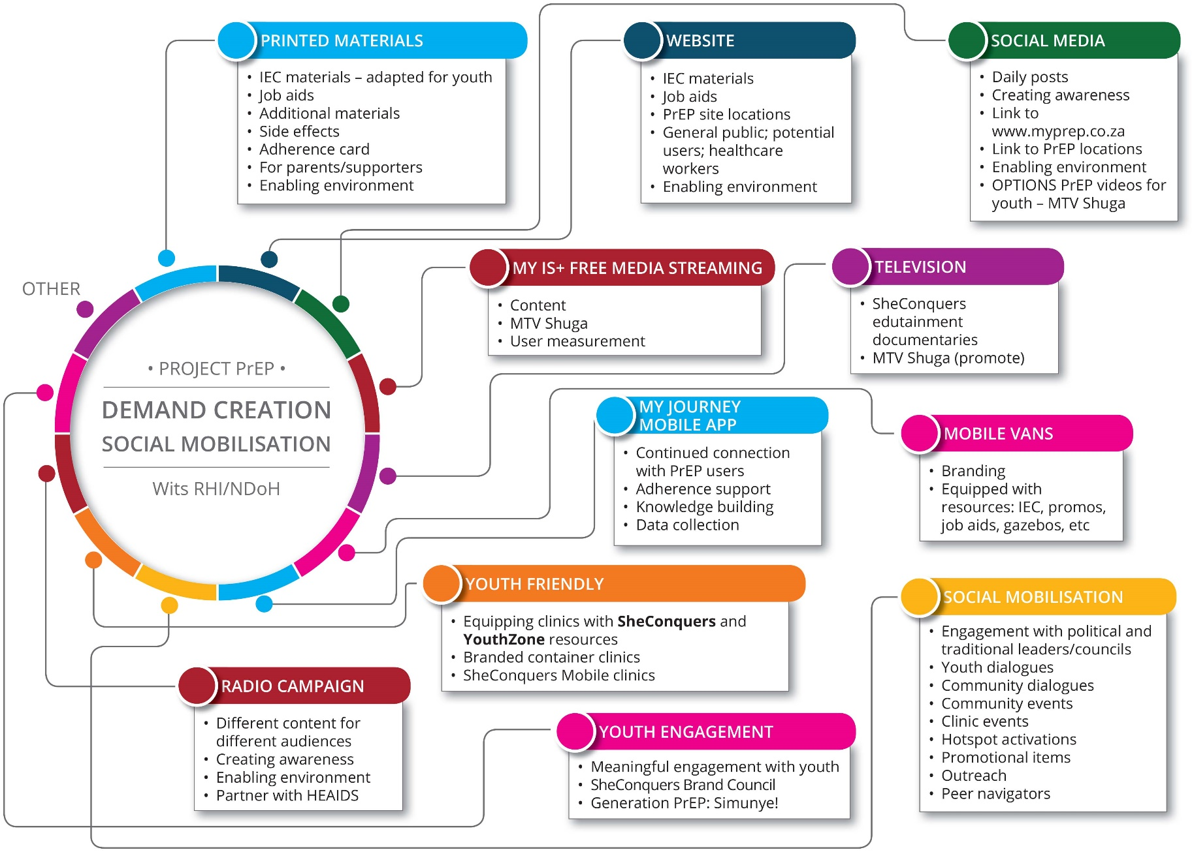
Demand Creation/Social Mobilisation Strategy – Reaching men by default
Strategy and messaging is aimed at at-risk AGYW
Men and boys are engaged as support structures for AGYW

Slide 15
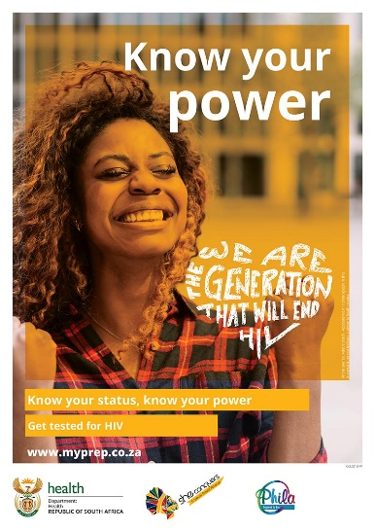
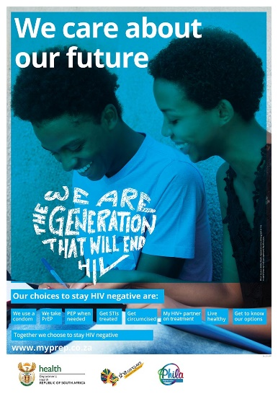
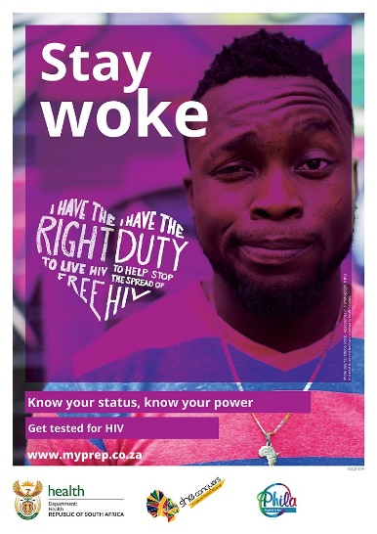
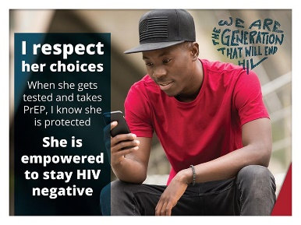
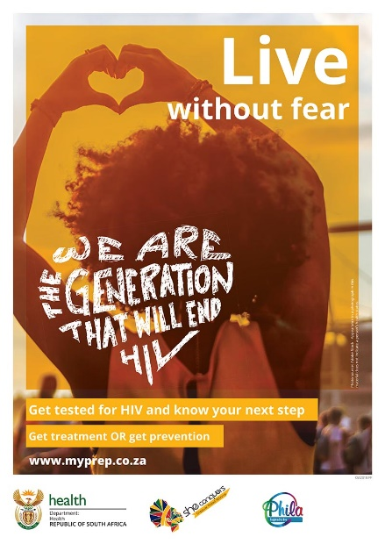
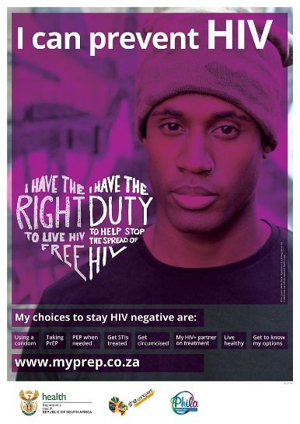
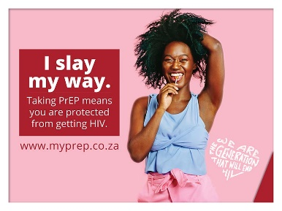
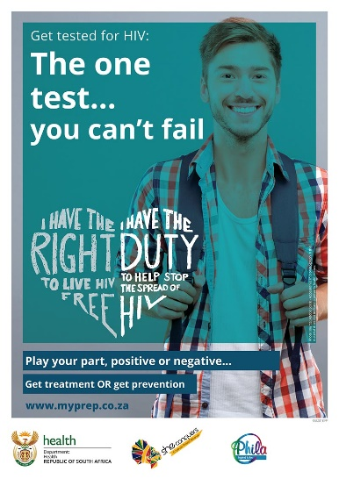
Youth Focused IEC Materials
AGYW do not exist in a vacuum, therefore Project PrEP IEC materials and messaging engage young women to consider PrEP while motivating young men and boys to play the role of supporter.
Non-gendered and positive, neutral messaging appeals to and is reaching all young people.

Slide 16
Directly reaching men – what works?
Adolescent boys and young men (ABYM) are engaged on an ongoing basis as supporters and motivators of AGYW – subsequently men are educated on PrEP and receive positive information through:
Health talks (in clinics)
Clinic Activation Events (targeting AGYW – VIP Youth Parties)
Stakeholder engagements (in community with various representatives – mixed gender and age)
Dialogues (in community with various community groups – mixed gender and age)
Social media (Facebook and Twitter)
Website (www.myprep.co.za)
Held in clinics: Outreach teams give talks to all in waiting rooms while targeting AGYW.
30%
70%
AGYW are targeted to attend these events through outreach and social media – subsequently ABYM are also reached.

Slide 17
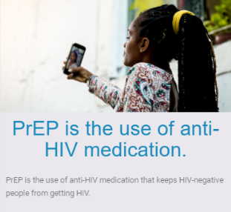
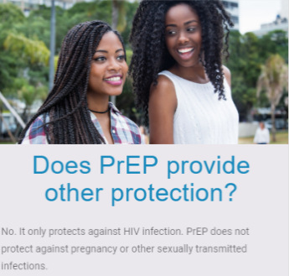
Men go online and actively seek out information about PrEP
www.myprep.co.za
Male 47%
Period: Dec 2018 – 30 June 2019, Data source: Google Analytics
16 516
users
22 Oct 18 to 30 Jun 19
Female 53%
Which topics are men most interested in?
Where can I get PrEP? 205 male views
What is PrEP? 181 male views
Other protection? 114 male views
Period: 4 December – 30 June 2019
Data source: Google Analytics

Slide 18
Men and social media
Facebook presents a greater total reach. A greater percentage of men are reached through Twitter but they are less willing to engage than those reached on Facebook.
Facebook
Twitter
Male 27%
Period: Since project inception, Nov 2018 – June 2019, Data source: Facebook, Twitter
Male 41%
7 125 page followers
605 762
reach
53 156 total
reach
Female 73%
Female 59%
Gender/Age disaggregated reach: Facebook and Twitter

Slide 19
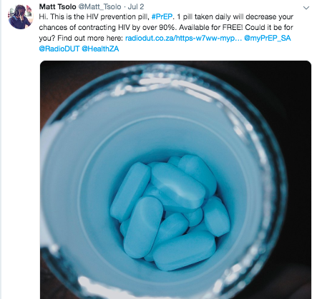
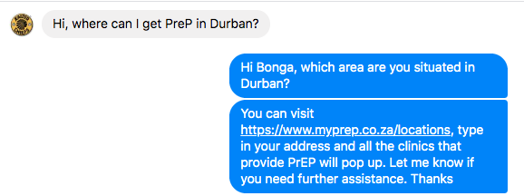
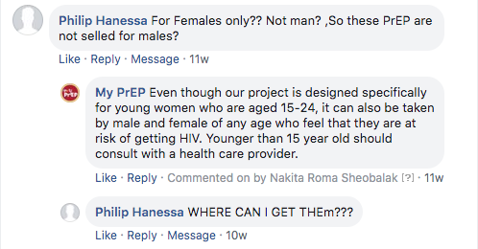
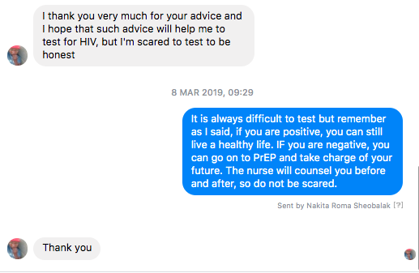
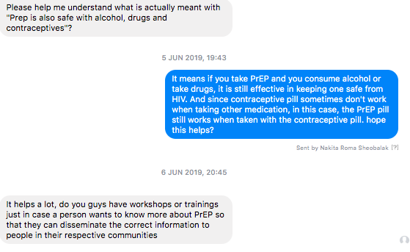
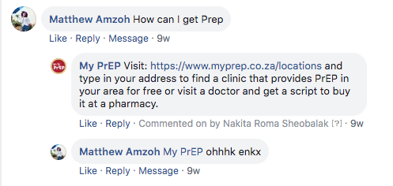
What men want to know…?
@myPrEPSouthAfrica
Where can I get it?
What is it?
Can men use it?
Fear of testing
Safe with alcohol and drugs
How can I get PrEP?

Slide 20
Project PrEP Cascade for Men:13 December 2018 – 28 June 2019
Source: Routine Monitoring Data

Slide 21
What is he thinking?
All photographs used are courtesy of Adobe Stock, standard licensing – appearance in a photograph in this presentation does not indicate a person’s health status.

Slide 22
Are the men coming to our sites at significant risk of HIV
Insights gathered from routine site monitoring visits:
At a Tshwane site, a number of young men confessed to indulging in sex under the influence of alcohol.
Men in Tshwane explained that their partners/girl friends are already living with HIV and AIDS and are on ART.
Men who come for PrEP are a mix of good income, professional careers and low socio-economic status.
A number of young men on PrEP are students at TVETS, universities and high schools.
Admitting to unprotected sex with multi-partners.
All photographs used are courtesy of Adobe Stock, standard licensing – appearance in a photograph in this presentation does not indicate a person’s health status.

Slide 23
What brought them in and which services are they accessing?
Insights gathered from routine site monitoring visits:
Colourful mobile clinic (van) parked at hotspots draw the attention of many men who then visit to explore services
Young men are brought to initiate PrEP by girl friends – confirmed observation across all clusters
Especially older men visit service delivery points with other ailments such as STIs, or for condom collection and are then informed about PrEP
Heard about PrEP during community and youth engage-ments
Demand creation:
Men specifically reached through radio
IEC material encoruaged men to visit the PE mobile clinic for PrEP

Slide 24
Men are partners, husbands, brothers and fathers.
All photographs used are courtesy of Adobe Stock, standard licensing – appearance in a photograph in this presentation does not indicate a person’s health status.

Slide 25
AGYW are having risky sex with their male partners
 | Port Elizabeth (EC) Peri-Urban (n=86) | Mthatha (EC) Peri-Rural (n=59) | Tshwane Urban (n=76)
Partner sex – Male | 90.7% (n=78) | 98.3% (n=58) | 98.7% (n=73)
Condom use (last sex) Half of the time Sometimes/ less than half Never | 5.9% (n=5) 28.2% (n=24) 42.4% (n=36) | 15.2% (n=9) 35.6% (n=21) 25.4% (n=15) | 19.7% (n=15) 23.7% (n=18) 7.9% (n=6)
Additional or side partners (among AGYW) | 18.6% (n=16) | 11.9% (n=7) | 10.8% (n=8)
Do you use condoms with side partners (No) | 43.8% (n=7) | 42.9% (n=3) | 12.5% (n=1)
Have you had sexual intercourse under the influence of alcohol | 29.1% (n=25) | 17% (n=10) | 42.1% (n=32)
Do you know if your partner has tested for HIV (No) | 68.3% (n=56) | 62.7% (n=37) | 44.7% (n=34)
Will you disclose PrEP use to your partner? (Yes) | 97.7% (n=85) | 93.2% (n=55) | 86.8% (n=66)
I think I am at risk of physical violence from my partner if I tell him I am using PrEP Strongly disagree | 96.5% (n=83) | 72.9% (n=43) | 88.2% (n=67)
AGYW Survey data

Slide 26
Conclusion
Men are interested and actively seek out information on PrEP
Social media, while reaching predominantly AGYW, also engages ABYM – these young men specifically engage via direct messaging which offers more privacy
Mobile van hotspot outreach targets AGYW but ABYM and even older men are often serviced at these mobile clinics.
Health talks in clinics by Peer Educators often attract the attention of ABYM and older men who actively engage about SRH and HIV prevention – the setting offers a direct link to service delivery.
Men are coming forward to initiate PrEP
A need for more data on “ other men who ask for PrEP” to support optimal service package and linkage strategies.
Reaching men through AGYW partners may also be a strategy to explore

Slide 27
Acknowledgements
Shona Dalal (WHO)
Rachel Baggaley (WHO)
Heather Ingold (Unitaid)
Unitaid for funding the Project PrEP initiative.
Project PrEP facility staff and mobile teams.
Hasina Subedar and DOH Staff
And Wits RHI staff:
Vusile Butler
Nicolette Naidoo
Elmari Briedenhann
Maserame Mojapele
Zukiswa Fipaza
Bongai Mundeta
Stanley Molefe
Letitia Rambally-Greener
Shawn Malone (PSI)
All photographs used are courtesy of Adobe Stock, standard licensing – appearance in a photograph in this presentation does not indicate a person’s health status.

Slide 28
Thank you!
All photographs used are courtesy of Adobe Stock, standard licensing – appearance in a photograph in this presentation does not indicate a person’s health status.

